Slide 1
Presentation Title
Dive deep without drowning in data: effective visualization of model predictions
Authors
Raghu Sidharthan, WSP
Rosella Picado, WSP
Notes:
This presentation aims at illustrating how the supply side of activities can be better represented in travel models by taking advantage of an Establishment Survey conducted by the Maricopa Association of Governments (MAG) in Phoenix, AZ in collaboration with their consultant team.

Slide 2
Motivation
Third Generation Activity Based Model
Activities instead of Tours
Detailed Model Outputs
Disaggregate Visualization
Model comprehension
Improve Behavioral Realism
Debug Efforts
Notes:
Third Generation Activity Base Models
Focus on activity instead of tours
Tour break instead of tour frequency
Linkage between children’s travel and chauffer's travel – school escorting model
Combinatorial mode choice that solves a tours trip mode choice jointly
Intermediate outputs for all the sub-models
Outputs from upstream models are used as constraints or pegs in the downstream models
Very rich and help to tell the story of how the household’s daily travel patterns emerge
Good understanding critical for using these tools effectively for project planning and evaluation,
Models increasingly difficult to grasp as complexity is added in the interest of properly simulating behavior.
Acceptance and usefulness hinges on how well it is understood by its users, and communicability of the model predictions
This ABM output visualization tool gives users a well-structured depiction of the model inner-workings, using modern web-based technologies

Slide 3
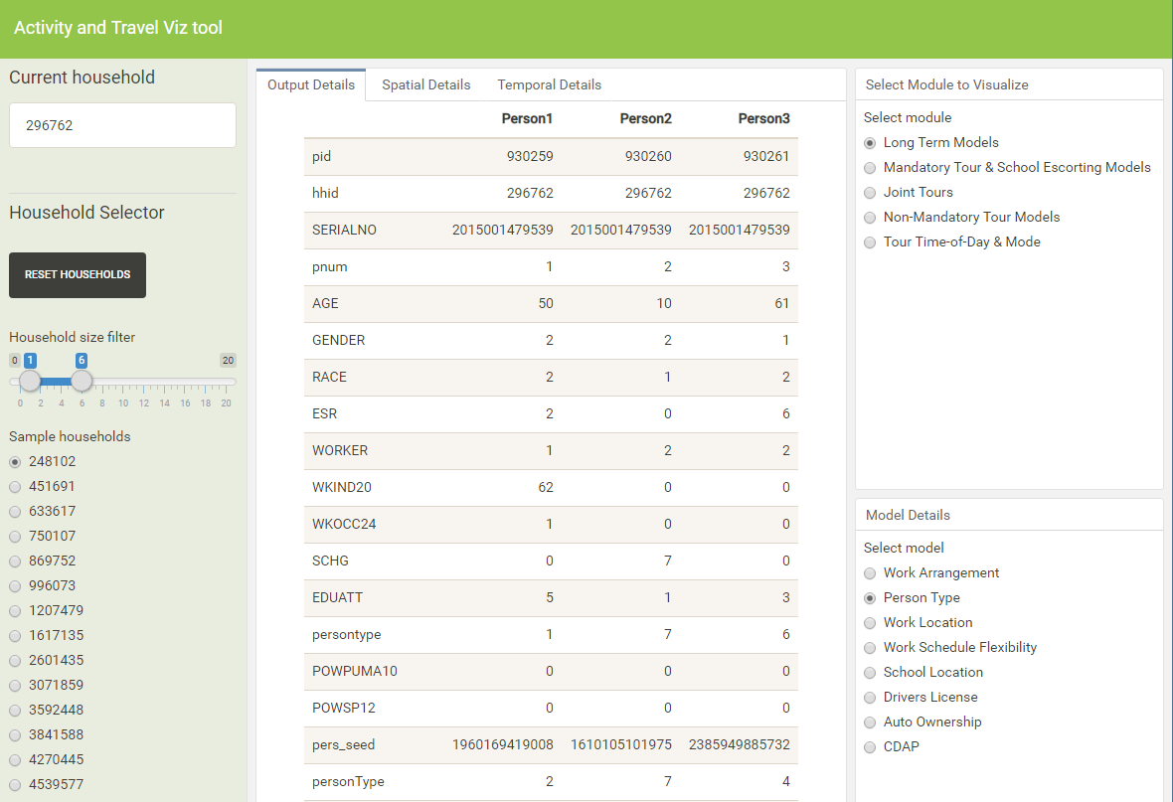
Model component Details
Module Selection Panel
Household Selector

Slide 4
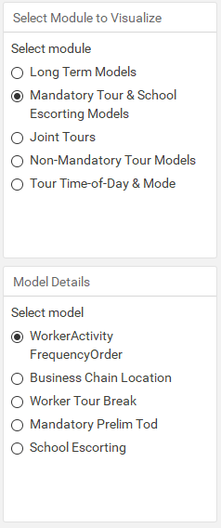
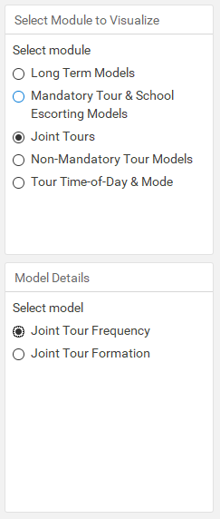
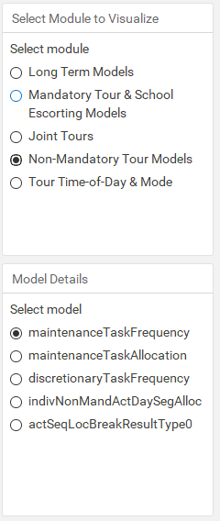
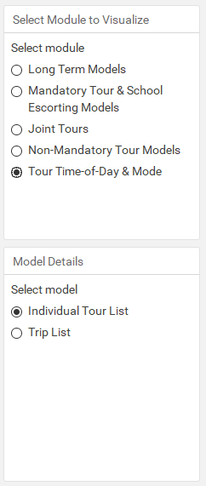
Other Module Details

Slide 5
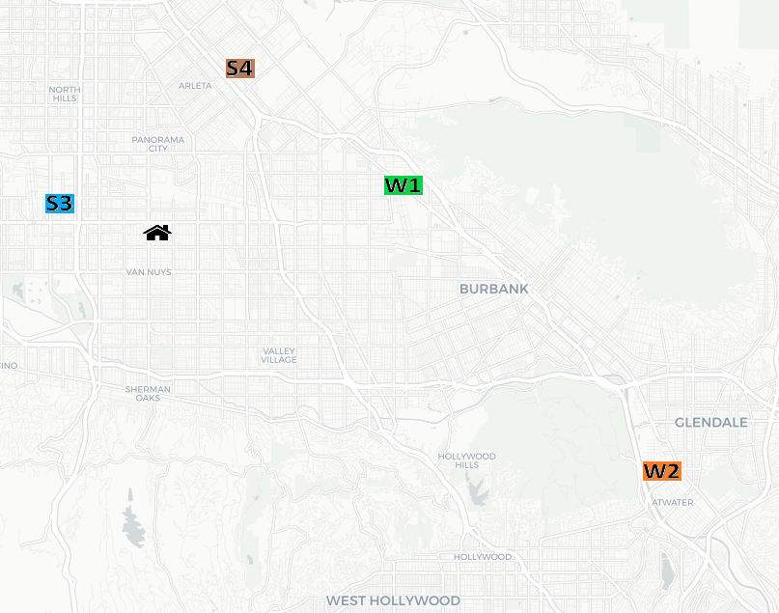
Spatial Tab: After Long Term Models

Slide 6
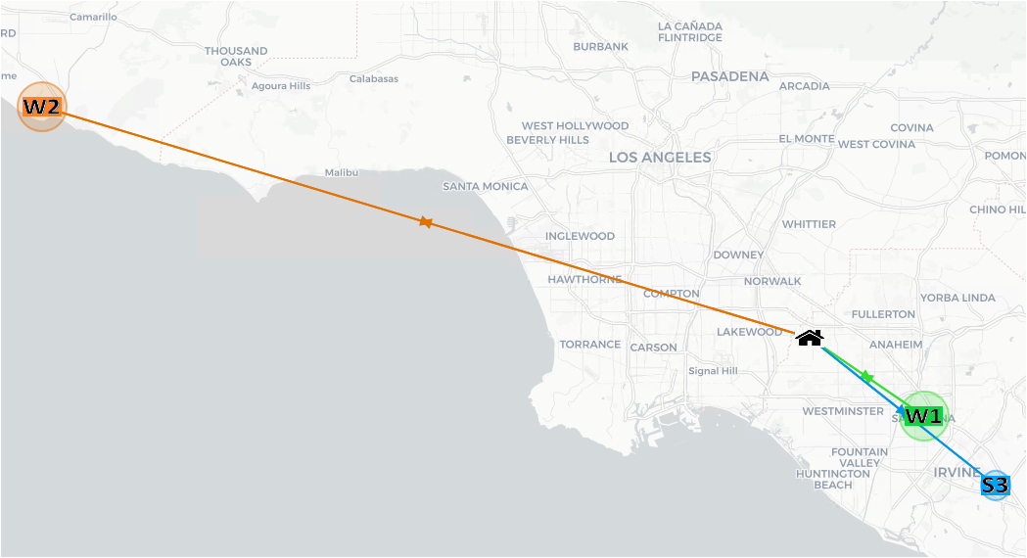
Spatial Tab: After Mandatory Tour Skeleton Models
Notes:
Household is 3770952 from 0.0001 sample

Slide 7
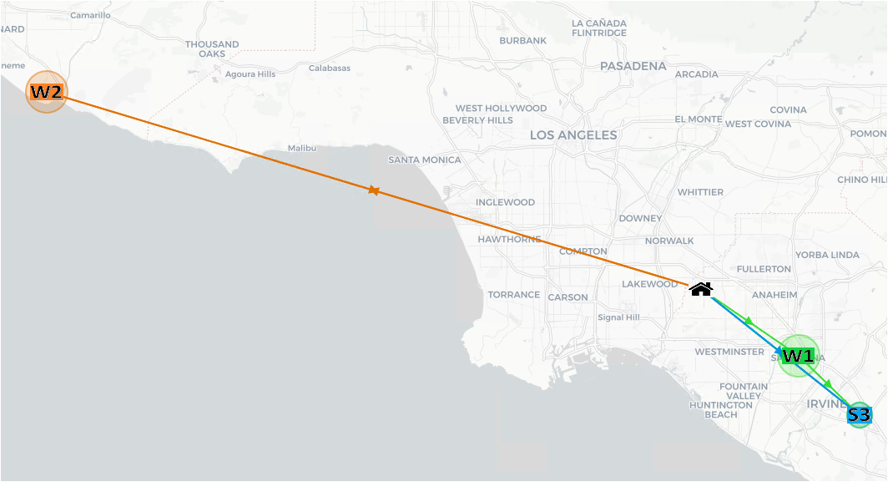
Spatial Tab: After School Escorting Model

Slide 8
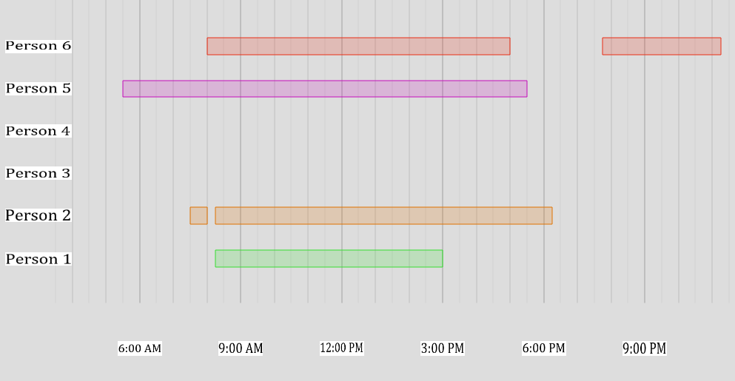
Temporal Tab: After School Escorting Model

Slide 9
Thank you
wsp.com

